Slide 1
Introduction of eBusiness Financial Gateway Project in GDCC
Shan Ying
April 5th, 2006

Slide 2

Project introduction
What is eBusiness Financial Gateway?
  credit card processing
  real-time authorization
  integrate with payment and risk management.
What is the counterpart team?
  eCommerce Services - Finance Gateway Team, Houston
Who is customer?
  Hp Shopping, ePrime,
  CitiGlobal, American Express

Slide 3
Project introduction
Team Website
  http://ecomm.goit.hp.com/ws/ws-fg.asp

Slide 4
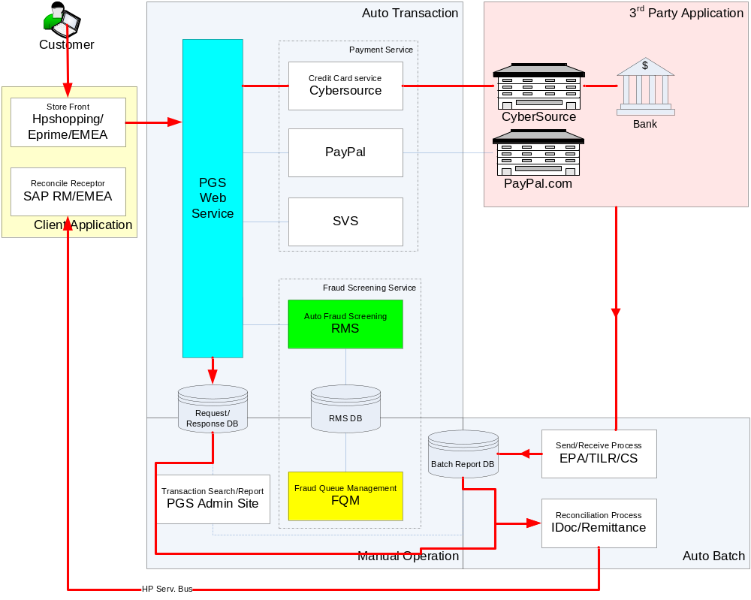
How Financial Gateway works
Notes:
（1）Client App?
(2) Store Front vs Reconcile Receptor? Reconciliation Process?
(3) EMEA?
(4)PGS Web Service responsibility?
(5)Does Fraud Screening service request for third party service Or just look up the database? Which system responsible for input fraud screening original data?
(6) SVS?
(7) Detail Business about the Fraud Screening

Slide 5
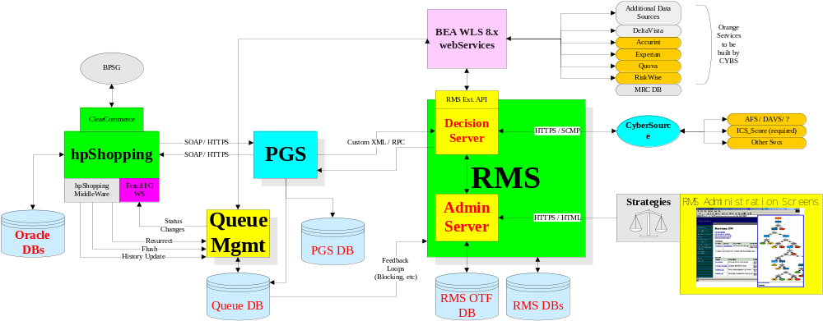
Overall Architecture

Slide 6

eBusiness Financial Gateway
3 Main Sub-Systems
PGS (Payment Gateway Service )
RMS (Risk Management System)
FQM (Fraud Queue Management)

Slide 7

PGS (Payment Gateway Service )
New fraud requests from the storefront start at the PGS
Provides a suite of credit card related services

Slide 8
How PGS Works

Slide 9
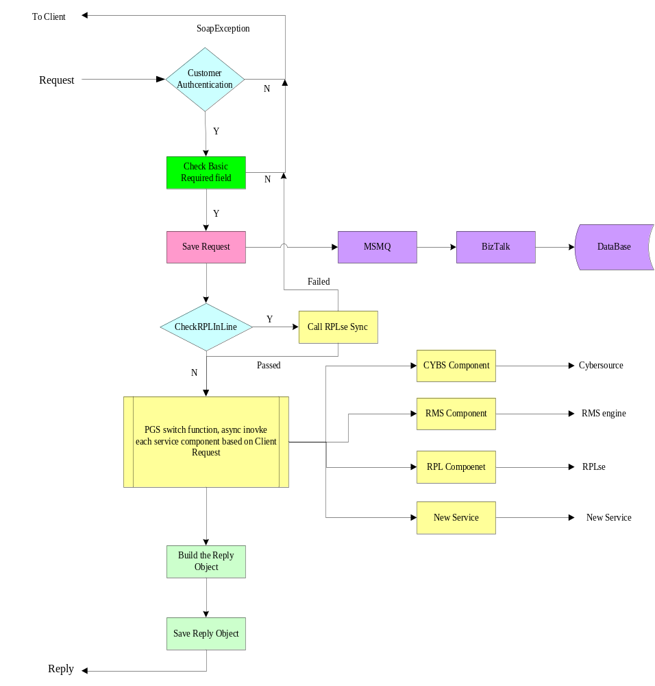

Slide 10

RMS (Risk Management System)
Order decision and risk management software solution
PGS will call the RMS application using the XML RPC format

Slide 11
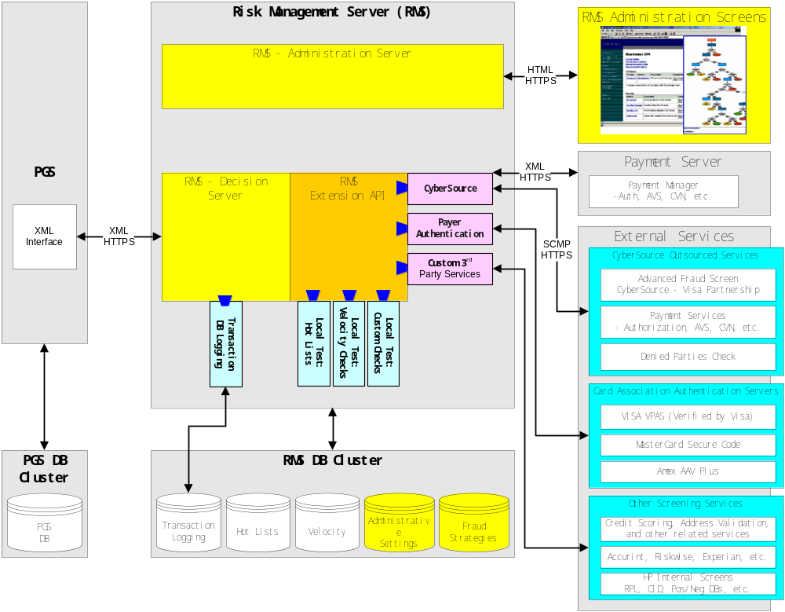

Slide 12
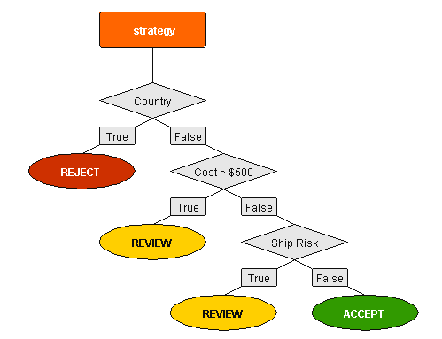
How Risk Manager Works

Slide 13

FQM (Fraud Queue Management)
FQM encompasses the fraud screening and management portfolio

Slide 14
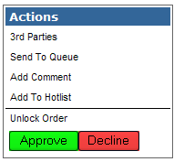
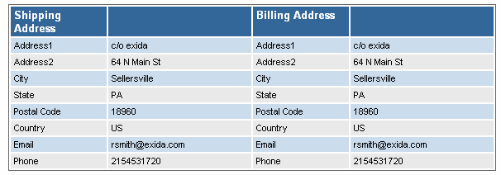
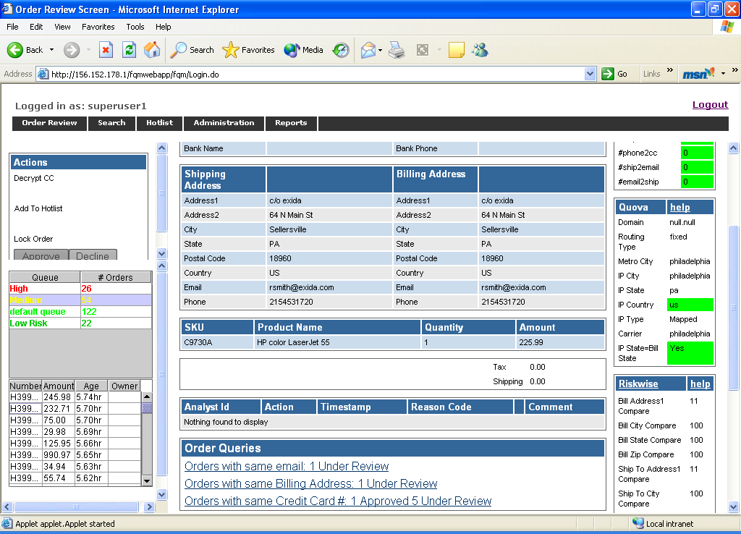
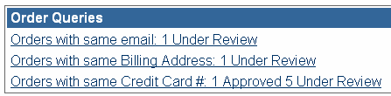
How FQM Works

Slide 15








Project Team
Project Manager
Andrews, Greg
Mao, JiaXi
Deborah, Eveleth
Chris, Mayor
Project Leader
Shan, Ying
Chen, Yang
Zhu, Lin
Zhu, Liang

Slide 16





Technologies
J2EE, EJB, Struts
Microsoft .Net framework
Microsoft SQL Server 2000
Weblogic 8.1 sp5
Web Services, Hibernate
HTML/JavaScript/XML

Slide 17


Thank You

